Slide 1
Pac-Man
Govardhan Padmanabhan
WID170715
17069496/1

Slide 2

Objective
To create a pacman controller.

Slide 3
Monte Carlo Tree Search
The idea behind Monte-Carlo algorithms in AI is that the approx. of future rewards can be achieved through random sampling.
Here, this approach is combined with a tree and effectively creating a stochastic best-first search.

Slide 4
Advantages
MCTS is a heuristic algorithm
MCTS supports asymmetric expansion of the search tree
Disadvantages
As the tree grows, the computation becomes costly
Needs huge number of iterations to be able to effective decide the most efficient path
MCTS returns the statistically best move, but might not always be the best case

Slide 5
Fast Approximate Max-n Monte Carlo Tree Search for Ms Pac-Man
S. Samothrakis, D. Robles and S. Lucas, "Fast Approximate Max-n Monte Carlo Tree Search for Ms Pac-Man," in IEEE Transactions on Computational Intelligence and AI in Games, vol. 3, no. 2, pp. 142-154, June 2011, doi: 10.1109/TCIAIG.2011.2144597.

Slide 6
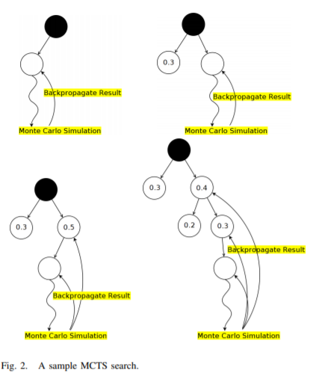
Brief Summary of Algorithm

Slide 7
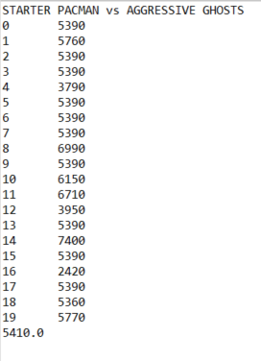
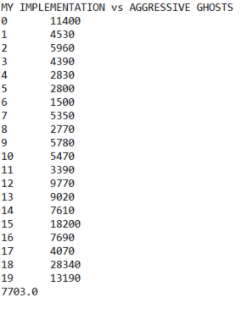
Results

Slide 8
Thank you

